Slide 1
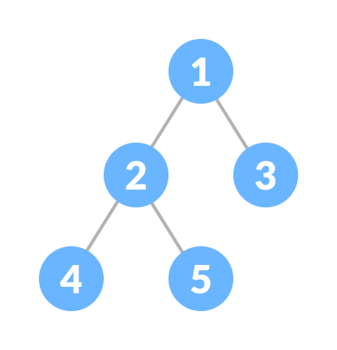
Binary Tree-
A binary tree is a tree data structure in which each parent node can have at most two children. For example,

Slide 2
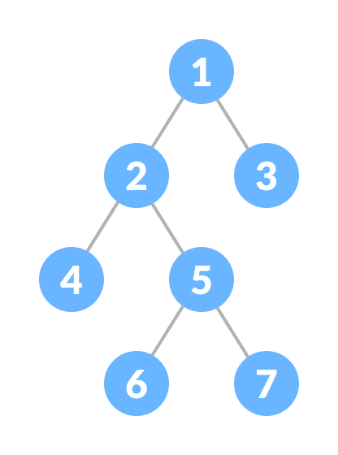
Types of Binary Tree
Full Binary Tree
A full Binary tree is a special type of binary tree in which every parent node/internal node has either two or no children.

Slide 3
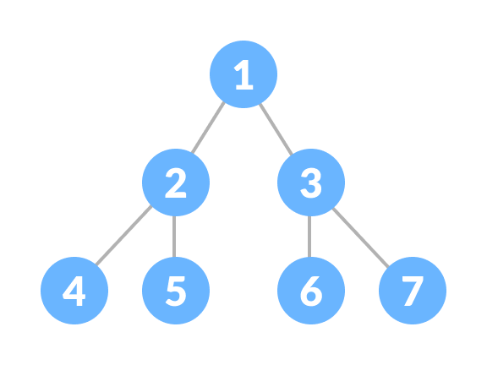
Perfect Binary Tree
A perfect binary tree is a type of binary tree in which every internal node has exactly two child nodes and all the leaf nodes are at the same level.

Slide 4
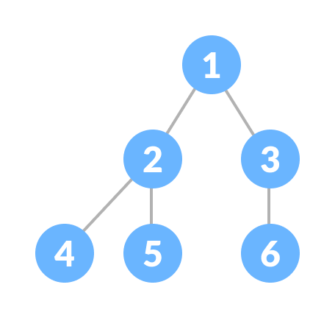
Complete Binary Tree
A complete binary tree is just like a full binary tree, but with two major differences
Every level must be completely filled
All the leaf elements must lean towards the left.
The last leaf element might not have a right sibling i.e. a complete binary tree doesn't have to be a full binary tree.

Slide 5
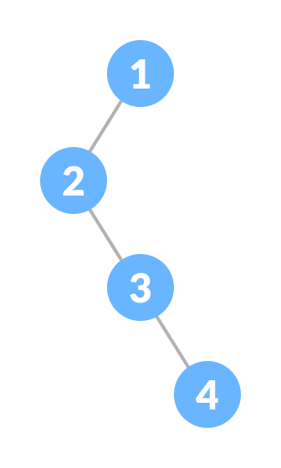
Degenerate or Pathological Tree
A degenerate or pathological tree is the tree having a single child either left or right.

Slide 6
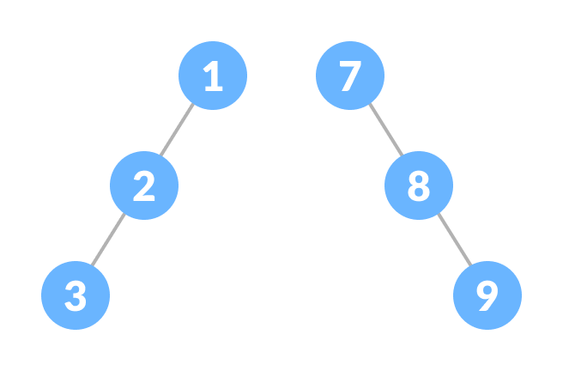
Skewed Binary Tree
A skewed binary tree is a pathological/degenerate tree in which the tree is either dominated by the left nodes or the right nodes. Thus, there are two types of skewed binary tree: left-skewed binary tree and right-skewed binary tree.

Slide 7
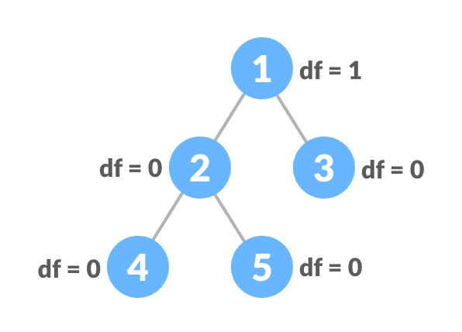
Balanced Binary Tree
It is a type of binary tree in which the difference between the height of the left and the right subtree for each node is either 0 or 1.

Slide 8
Binary Tree Representation
A node of a binary tree is represented by a structure containing a data part and two pointers to other structures of the same type.
struct node
{
int data;
struct node *left;
struct node *right;
};

Slide 9
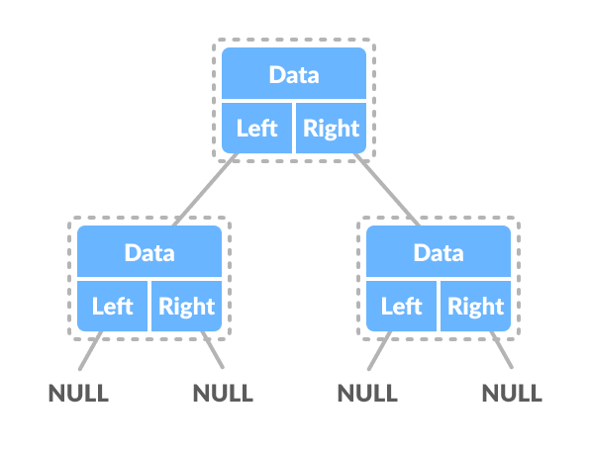

Slide 10
Binary Tree Applications
For easy and quick access to data
In router algorithms
To implement heap data structure
Syntax tree

Slide 11
A Binary Search Tree (BST) is a tree in which all the nodes follow the below-mentioned properties −
The value of the key of the left sub-tree is less than the value of its parent (root) node's key.
The value of the key of the right sub-tree is greater than or equal to the value of its parent (root) node's key.
Thus, BST divides all its sub-trees into two segments; the left sub-tree and the right sub-tree and can be defined as −
left_subtree (keys) < node (key) ≤ right_subtree (keys)

Slide 12
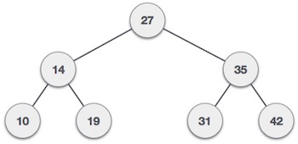
Representation
BST is a collection of nodes arranged in a way where they maintain BST properties. Each node has a key and an associated value. While searching, the desired key is compared to the keys in BST and if found, the associated value is retrieved.
Following is a pictorial representation of BST −

Slide 13
Basic Operations
Following are the basic operations of a tree −
Search − Searches an element in a tree.
Insert − Inserts an element in a tree.
Pre-order Traversal − Traverses a tree in a pre-order manner.
In-order Traversal − Traverses a tree in an in-order manner.
Post-order Traversal − Traverses a tree in a post-order manner.

Slide 14
Node
Define a node having some data, references to its left and right child nodes.
struct node {
int data;
struct node *leftChild;
struct node *rightChild;
};
Search Operation
Whenever an element is to be searched, start searching from the root node. Then if the data is less than the key value, search for the element in the left subtree. Otherwise, search for the element in the right subtree. Follow the same algorithm for each node.

Slide 15
Algorithm
If root.data is equal to search.data
return root
else
while data not found
If data is greater than node.data
goto right subtree
else
goto left subtree
If data found
return node
endwhile
return data not found
end if

Slide 16
struct node* search(int data){
struct node *current = root;
printf("Visiting elements: ");
while(current->data != data){
if(current != NULL) {
printf("%d ",current->data);
//go to left tree
if(current->data > data){
current = current->leftChild;
} //else go to right tree
else {
current = current->rightChild;
}
//not found
if(current == NULL){
return NULL;
}
}
}
return current;
}

Slide 17
Insert Operation
Whenever an element is to be inserted, first locate its proper location. Start searching from the root node, then if the data is less than the key value, search for the empty location in the left subtree and insert the data. Otherwise, search for the empty location in the right subtree and insert the data.

Slide 18
Algorithm
If root is NULL
then create root node
return
If root exists then
compare the data with node.data
while until insertion position is located
If data is greater than node.data
goto right subtree
else
goto left subtree
endwhile
insert data
end If

Slide 19
void insert(int data) {
struct node *tempNode = (struct node*) malloc(sizeof(struct node));
struct node *current;
struct node *parent;
tempNode->data = data;
tempNode->leftChild = NULL;
tempNode->rightChild = NULL;
//if tree is empty
if(root == NULL) {
root = tempNode;
} else {
current = root;
parent = NULL;

Slide 20
while(1) {
parent = current;
//go to left of the tree
if(data < parent->data) {
current = current->leftChild;
//insert to the left
if(current == NULL) {
parent->leftChild = tempNode;
return;
}
} //go to right of the tree
else {
current = current->rightChild;
//insert to the right
if(current == NULL) {
parent->rightChild = tempNode;
return;
}
}
}
}
}

Slide 21
Delete Operation binary search tree (BST)
delete operation is dropping the specified node from the tree. in case deleting the nodes, there are three possibilities −
Deleting a leaf node from the tree: The simplest deletion is the deletion of a leaf node from the binary search tree. For deleting the leaf node only the leaf gets affected. Example,

Slide 22
Algorithm to delete a node in a Binary Search Tree
Input the number of nodes.
Input the nodes of the tree.
Consider the first element as the root element and insert all the elements.
Input the data of the node to be deleted.
If the node is a leaf node, delete the node directly.
Else if the node has one child, copy the child to the node to be deleted and delete the child node.
Else if the node has two children, find the inorder successor of the node.
Copy the contents of the inorder successor to the node to be deleted and delete the inorder successor.

Slide 23
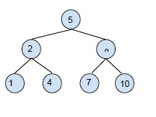
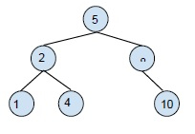
deleting the leaf node 7 gives,

Slide 24
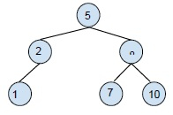
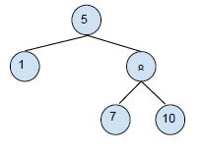
Deleting the node with one child node: for this deletion, you need to replace the child node with the node to be deleted and then delete it. Example,
Deleting 2 from the BST

Slide 25
Deleting the node with two child nodes: Here the node to be deleted has two child nodes. So, we will use in the order form of the tree, here we will delete the element and select its inorder neighbor for its place and recreate the rest. Example,

Slide 26
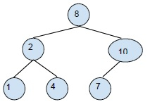
Deleting 5 from the BST will return the following tree.

Slide 27
struct node* delete(struct node *root, int x)
{
if(root==NULL)
return NULL;
if (x>root->data)
root->right_child = delete(root->right_child, x);
else if(x<root->data)
root->left_child = delete(root->left_child, x);
else
{
//No Children
if(root->left_child==NULL && root->right_child==NULL)
{
free(root);
return NULL;
}
//One Child
else if(root->left_child==NULL || root->right_child==NULL)
{
struct node *temp;
if(root->left_child==NULL)
temp = root->right_child;
else
temp = root->left_child;
free(root);
return temp;
}
//Two Children
else
{
struct node *temp = find_minimum(root->right_child);
root->data = temp->data;
root->right_child = delete(root->right_child, temp->data);
}
}
return root;
}

Slide 28
Non Recursive Tree Traversal Algorithm
POSTORD(INFO, LEFT, RIGHT, ROOT)
Step-1 [Push NULL onto STACK and initialize PTR]
Set TOP=1, STACK[1]=NULL and PTR=ROOT.
Step-2 [Push left-most path onto STACK] repeat step 3 to 5 while PTR not equal NULL.
Step-3 set TOP=TOP+1 and STACK[TOP]=PTR. [Pushes PTR on STACK].
Step-4 if RIGHT[PTR] not equal NULL then [push on STACK.]
Set TOP=TOP+1 and STACK[TOP]= RIGHT[PTR]
[End of if structure]
Step-5 set PTR = LEFT[PTR].[Update pointer PTR]
[End of step 2 loop].

Slide 29
Step-6 set PTR= STACK[TOP] and TOP=TOP-1.
[Pops node from STACK].
Step-7 Repeat while PTR>0;
Apply PROCESS TO INFO[PTR].
Set PTR= STACK[TOP] and TOP= TOP-1.
[Pops node from STACK]
[End of loop]
Step-8 if PTR<0 then:
Set PTR= -PTR
Go to step 2
[End of if structure]
Step-9 Exit.

Slide 30
INORD( INFO, LEFT, RIGHT, ROOT)
Step-1 [Push NULL onto STACK and initialize PTR;]
Set TOP=1 STACK[1]= NULL and PTR=ROOT.
Step-2 Repeat while PTR not equal NULL[Pushes left most path onto STACK].
a) Set TOP=TOP+1 and STACK[TOP]=PTR [saves node]
b) Set PTR=LEFT[PTR] [updates PTR]
[End of loop]
Step-3 set PTR= STACK[TOP and TOP=TOP-1.[pops node from STACK].
Step-4 Repeat step 5 to 7 while PTR is not equal to Null; [backtracking].
Step-5 Apply PROCESS to INFO[PTR],

Slide 31
Step-6 [RIGHT child?] if RIGHT[PTR] is not equal NULL then.
a) Set PTR=RIGHT[PTR]
b) Go to step 3.[End of if structure.]
Step-7 set PTR= STACK[TOP] and TOP=TOP-1. [pops node]
[End of step 4 loop]
Step-8 Exit.

Slide 32
PREORDER( INFO, LEFT,RIGHT, ROOT)
Step-1 [initially push NULL onto stack and initialize PTR.]
Set TOP=1 STACK[1]=NULL and PTR= ROOT.
Step-2 Repeat step 3 to 5 while PTR not equal NULL.
Step-3 Apply PROCESS to INFO[PTR].
Step-4 [RIGHT child?]
If RIGHT[PTR] not equal NULL then [PUSH on STACK]
Set TOP= TOP+1 and STACK[TOP]= RIGHT[PTR]
[End of if structure.]

Slide 33
Step-5 [LEFT child?]
If LEFT[PTR] not equal NULL then
Set PTR= LEFT[PTR].
Else [pop from STACK;]
Set PTR= STACK[TOP] and TOP=TOP+!;
[End of if structure]
[End of step 2 loop]
Step-6 Exit.

Slide 34
Thanks

